Slide 1
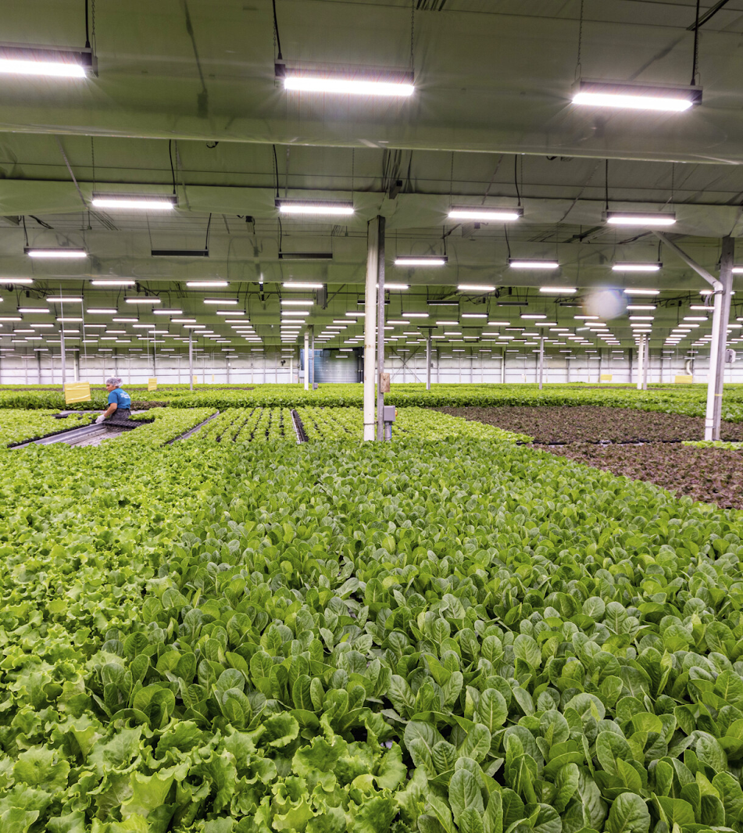
Controlled Environment Agriculture: A Case in Agricultural Transformation
Abigail Boyd, PhD
ORISE Postdoctoral Fellow
Hosting agency: USDA-ARS
Beltsville, MD
www.s2gventures.com
Notes:
Societal challenges, such as climate change and nutrition security threaten our agricultural systems. Thus, transformation is warranted. One avenue to transformation is controlled environment agriculture (CEA), which is the case I will discuss today.
However, I want attendees of all disciplines to think of how these concepts apply beyond CEA

Slide 2
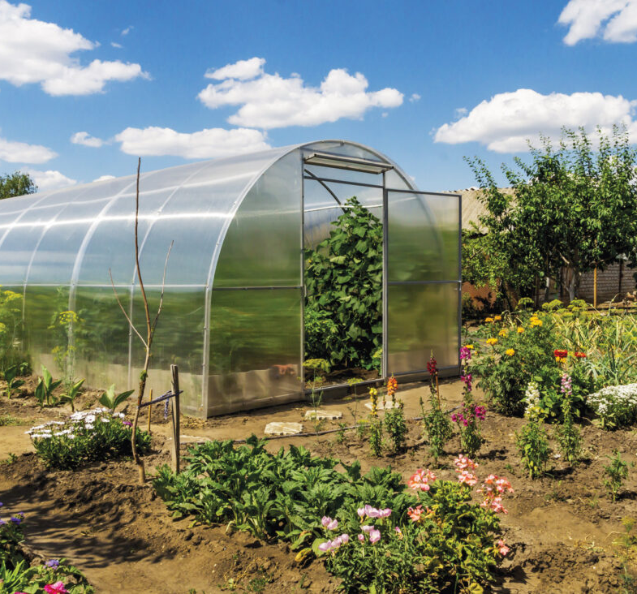
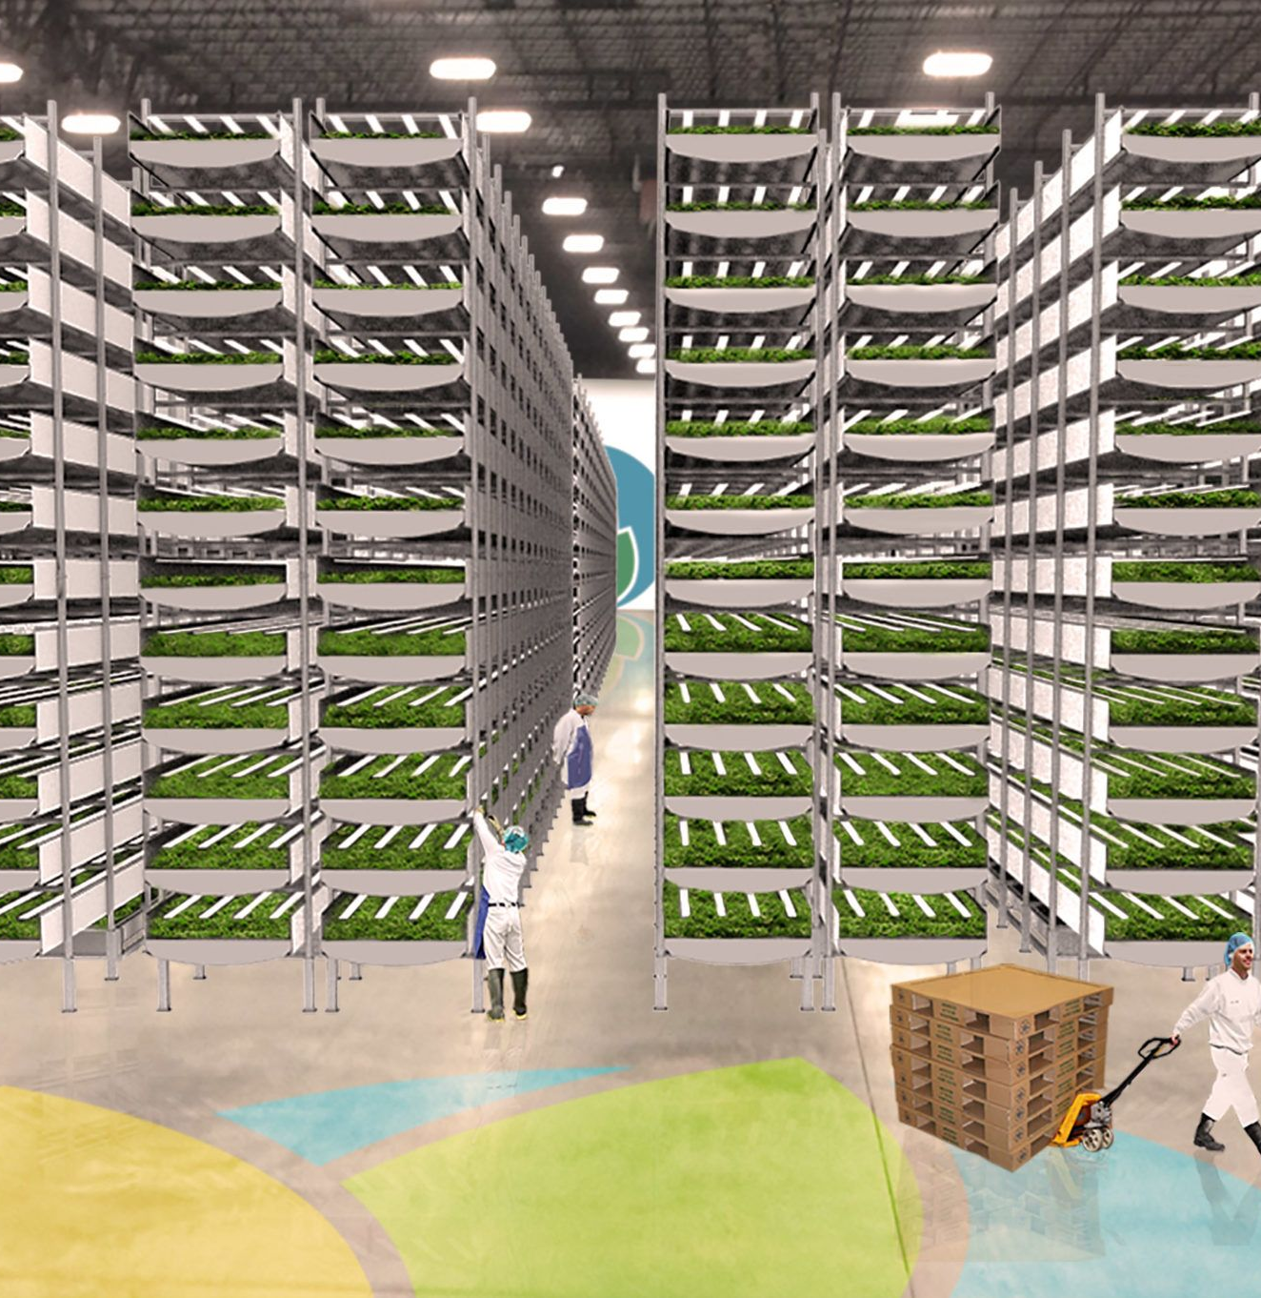
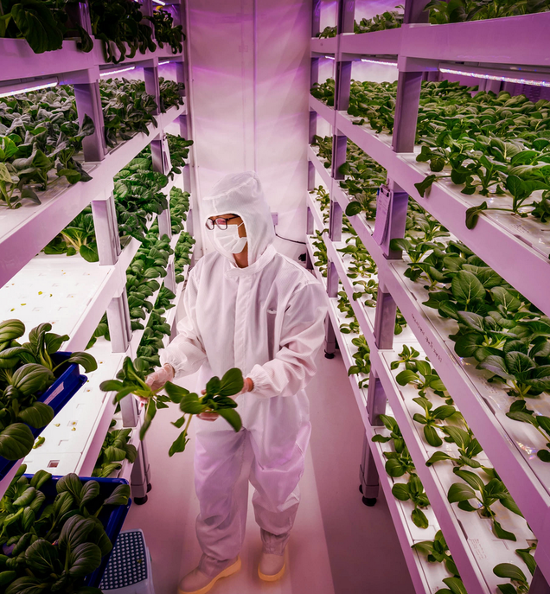
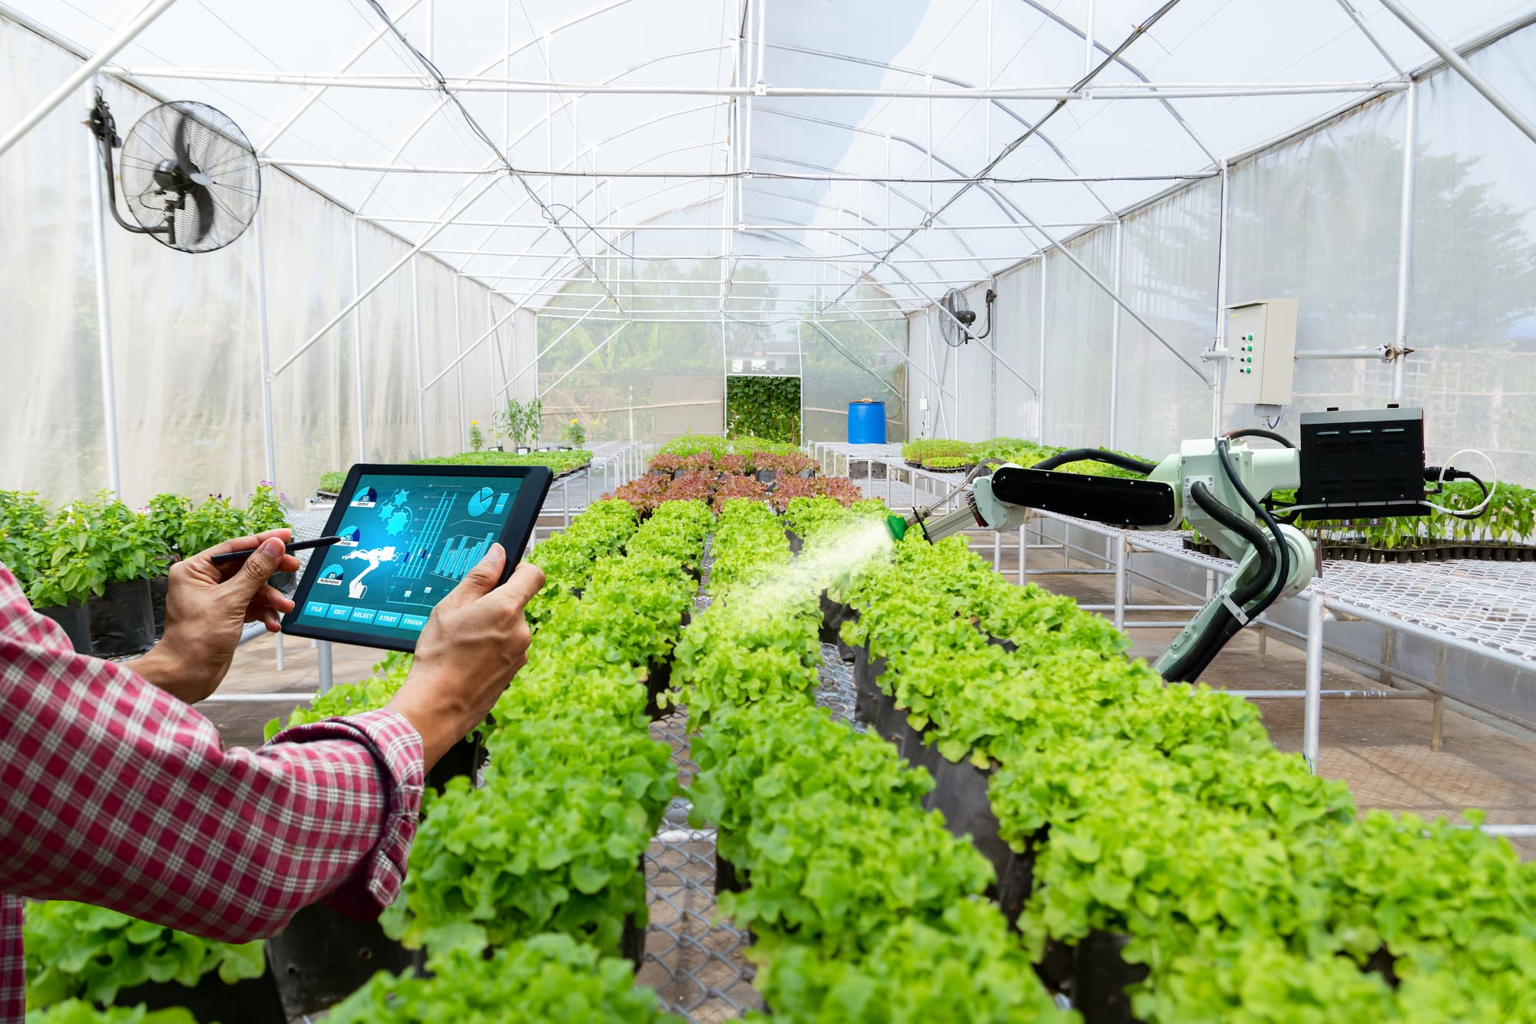
Controlled Environment Agriculture (CEA)
Enclosed growing environment, most commonly for leafy greens, tomatoes, and strawberries
Variables such as light, humidity, temperature, and nutrients may be regulated
Can be as simple as a backyard hoop house or as complex as an automated plant factory
Notes:
Typically used for leafy greens, microgreens, tomatoes, peppers, strawberries, etc. More recently, there is increased interest in adapting more crops to CEA, especially staple crops for more caloric density, as well as incorporating animal agriculture, such as aquaponics.
CEA research and industry have grown steadily over the last decade, with potential for enhancing climate adaptation, nutrition security and more. However….
Hoop house: https://www.motherearthnews.com/organic-gardening/site-hoop-house-zm0z21fmzbut/
Smart greenhouse: https://www.advantech.com/en/resources/case-study/greenhouse-smart-application-project-that-reduces-waste-and-improves-workforce-efficiency-at-farms-in-spain
Vertical farm: https://en.wikipedia.org/wiki/File:Sgverticalfarming1.png#filelinks
Plant Factory: https://agfundernews.com/aerofarms-raises-100m-from-patient-capital-to-continue-steady-growth-of-vertical-farming-business

Slide 3
Notes:
In the past decade+, the CEA industry saw steady growth and investment. However, in 2023…
Many industry closures and restructuring in 2023, especially in those relying on 100% artificial light (extremely high energy costs), combined with post-covid economic challenges, it became difficult for vertical farms to scale sustainably.

Slide 4
CEA Research Outlook
The 2023-2026 USDA Science and Research Strategy includes numerous priorities relevant to advancing CEA
Accelerating Innovative Technologies & Practices
Driving Climate-Smart Solutions
Bolstering Nutrition Security & Health
Despite industry challenges, CEA research remains a priority.
Notes:
CEA still offers many potential benefits in the face of climate change and food insecurity, and is well worth continued investigation
It remains a priority for the federal government and is especially aligned with research priorities in the USDA Science and Research Strategy released last year.

Slide 5
How can government research initiatives stimulate CEA?
Notes:
Scientific agencies can signal to the industry that the federal government is committed to supporting the CEA industry by answering industry research questions and allowing them to redirect R&D resources into scaling their businesses sustainably.

Slide 6
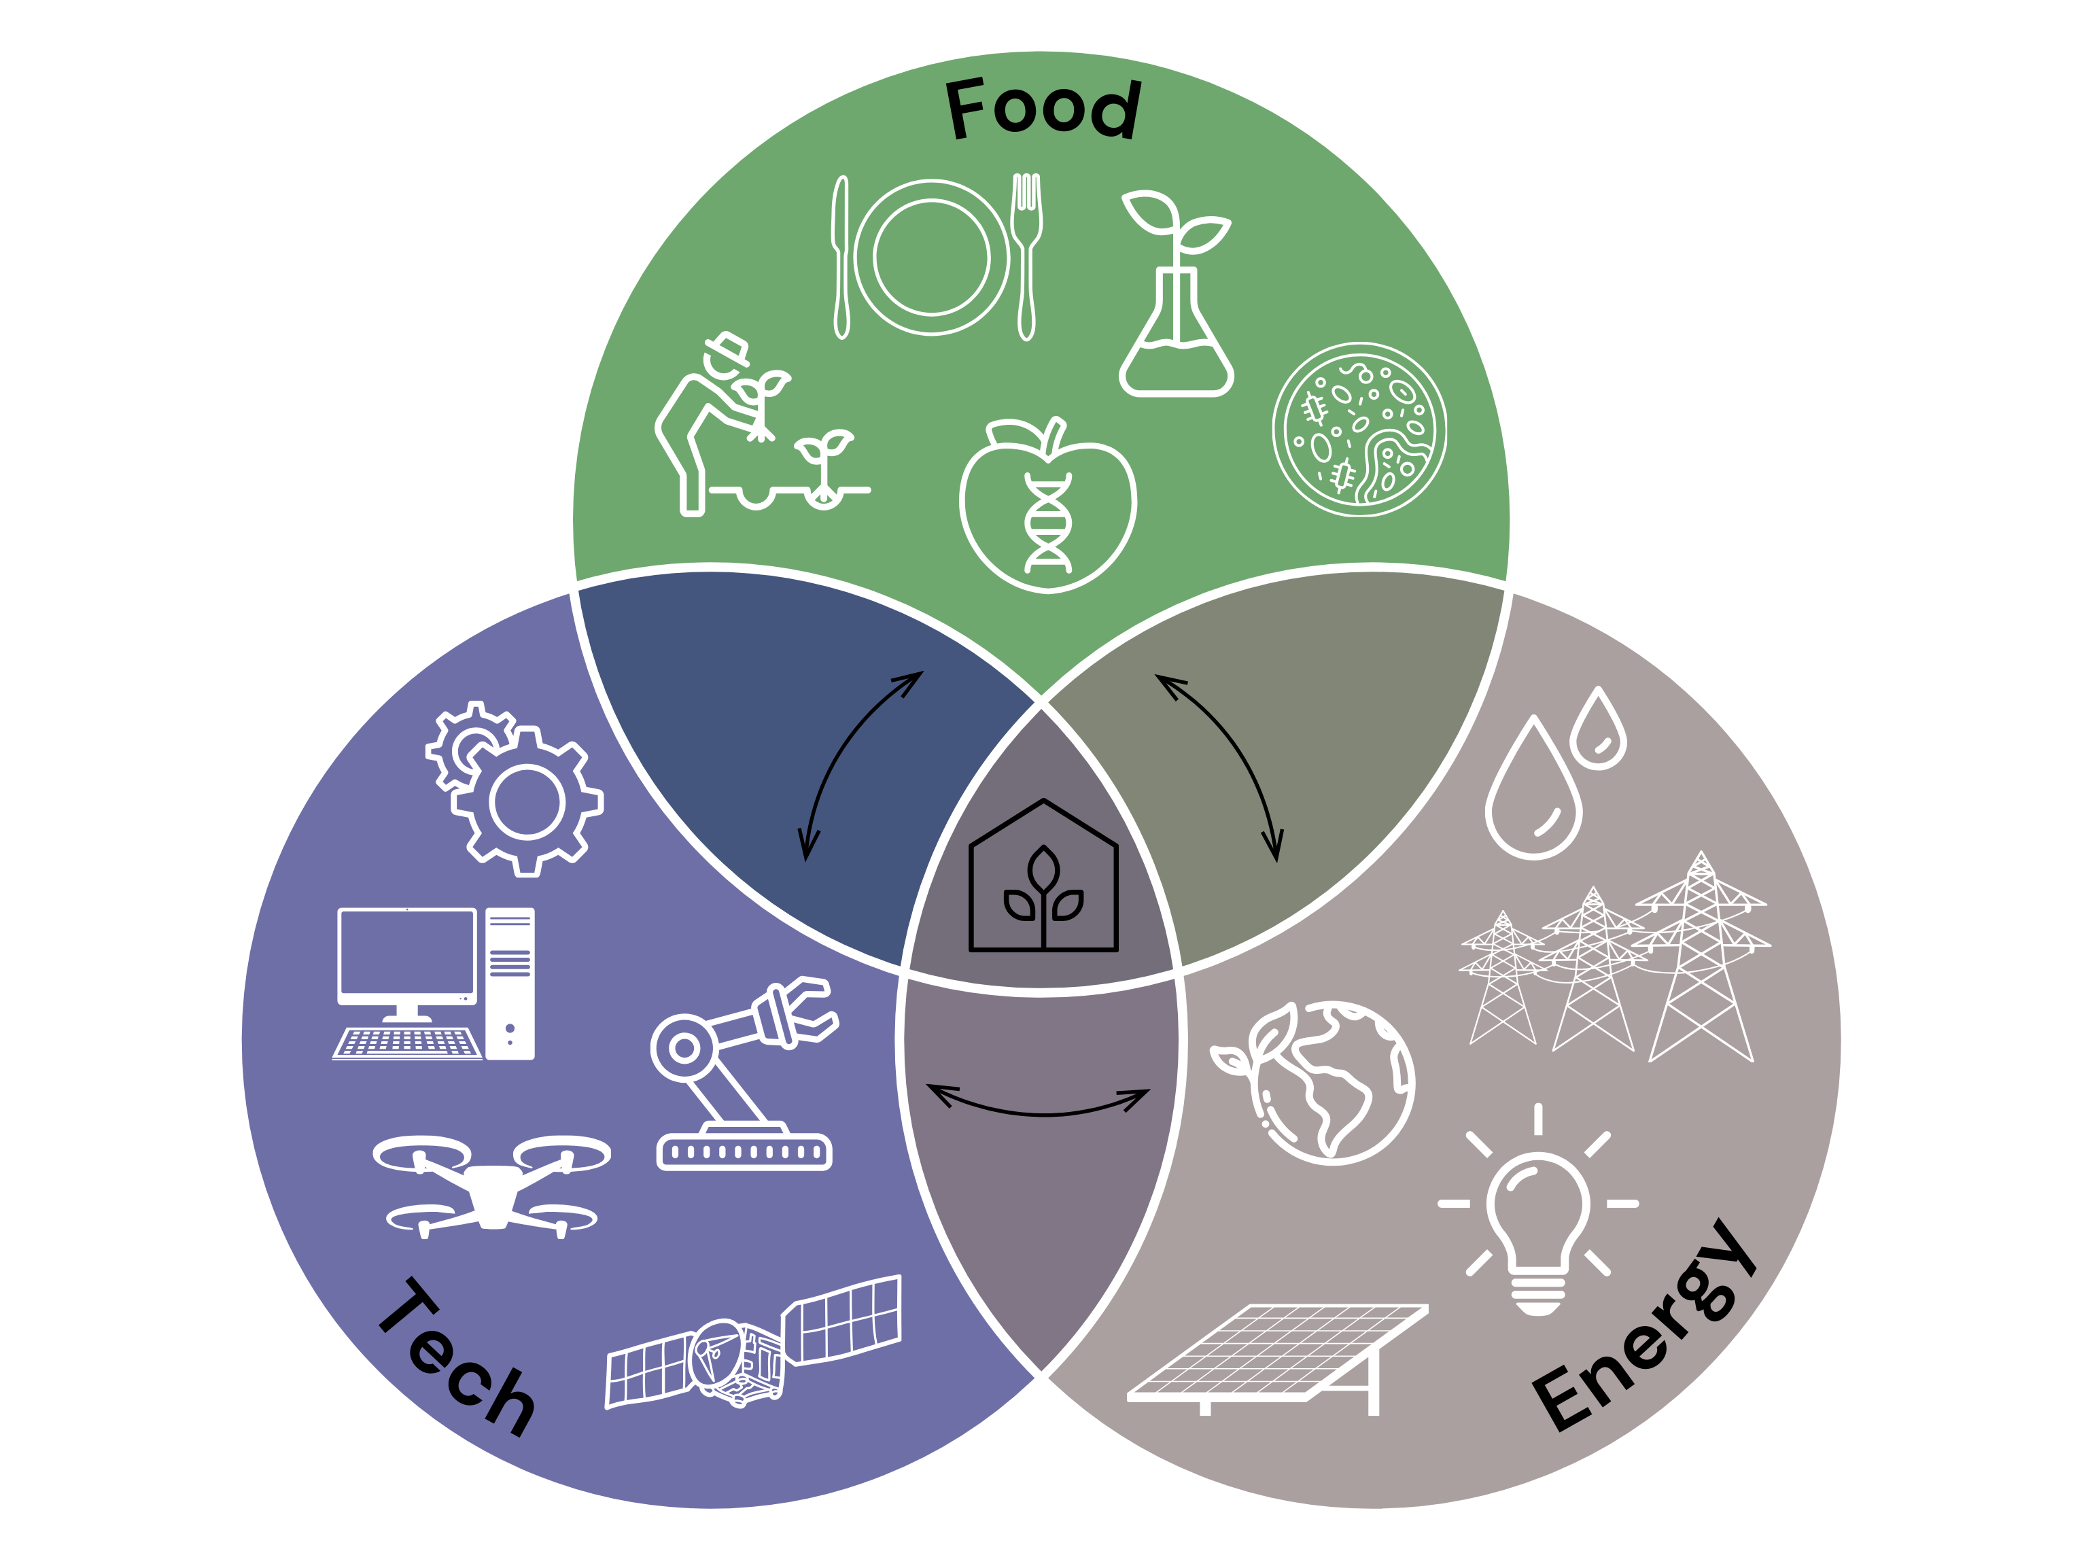
Improving plant genetics
Promoting food safety
Investigating the microbiome
Developing new crops
Optimizing input variables
Enhancing nutrient profile
Water quality and conservation
High performance computing
Optimizing lighting efficiency
Remote sensing
Building efficient production facilities
Automation
Integrating renewable energy
Employing artificial intelligence
Notes:
What makes CEA such a great case for cross-agency collaboration is that it is transdisciplinary in nature: food, tech, energy industries all significantly implicated, which means it requires more than just agricultural expertise
Challenge is to integrate across industries and disciplines, gives companies an “identity crisis” and makes it difficult to focus R&D and product offerings
Outside the figure are examples of current and future research interests related to CEA, many of which cut across sectors and disciplines

Slide 7
Agency | Expertise | Resources
USDA | horticulture, plant physiology, biology, nutrition, food science, animal science, pathogen and disease responses, food safety | ARS, ERS, NIFA, Climate Hubs, OUAIP, AgARDA
NASA | engineering, life sciences, innovation, tech transfer, remote sensing | NASA Technology Transfer Program, STEM Engagement programs and funding
DOE | energy efficiency, renewable power, policy and analysis, decarbonization | EERE, CEA Accelerator, funding and technical expertise, ARPA-E
FDA | food safety, nutrition, policy, extension and outreach | regulatory and safety information, notices of outbreaks, investigations, reports, recommendations
NIH | biomedical science, nutrition, environmental health sciences, extension and outreach | grants and funding, health and nutrition information, NIH Intramural Research Program, ARPA-H
Notes:
USDA is not the only agency at play here.
This table is not at all exhaustive, but it summarizes agencies with relevant resources and expertise. The potential for CEA support is abundant across the federal government, the challenge is to coordinate it and help agencies develop robust collaborations that take advantage of all available resources.
USDA, NASA, and DOE have demonstrated coordination and collaboration, as illustrated by regular joint workshops (since 2018), and existing cross-agency MOUs. FDA and NIH have also started CEA working groups.

Slide 8
Existing Collaborations
DOE and USDA: Water, Energy, and the Future of Farming
September 2023: DOE initiated its CEA Accelerator program, providing $2.5 million to support innovation in CEA nationwide; Lawrence Berkeley National Laboratory leading the 2-year program in consultation with USDA and nonprofit partners
USDA and NASA: Advancing Science and Exploration
June 2023: MOU between agencies to continue partnerships in agricultural and Earth sciences, including research collaborations between ARS and NASA scientists to grow fresh produce on the International Space Station.
Notes:
https://www.energy.gov/eere/iedo/articles/water-energy-and-future-farming
https://www.energy.gov/eere/iedo/nexus-energy-water-and-agriculture
https://www.annualreviews.org/doi/10.1146/annurev-food-060721-024636
https://www.usda.gov/media/press-releases/2023/06/21/us-department-agriculture-nasa-advance-exploration-science

Slide 9
Strengthening Cross-Agency Research Collaborations
Organize personnel and consolidate resources
Build on existing multi-agency collaborations and convenings
Engage additional collaboration opportunities
Notes:
Based on the current landscape of federal CEA collaboration, I provide these three main recommendations for advancing cross-agency efforts.

Slide 10
Organize
Expedite project initiation
Maintain professional networks
Notes:
Organize: ensure directory is up to date, reflecting regular personnel changes (especially with short term contractors and fellows participating in federal research), also include relevant publications and workshop proceedings, which would expedite project initiation as new researchers join the space and new research questions arise

Slide 11
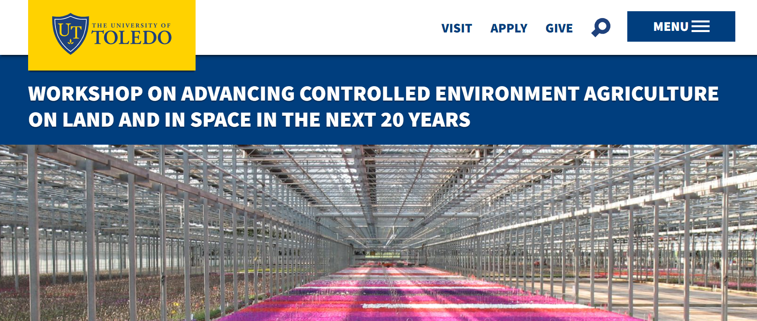
Build
Since 2018, USDA, NASA, and DOE researchers have convened with academic, non-profit, and industry representatives to discuss challenges and opportunities in CEA research.
Future workshops should allocate time for government researchers and program leaders to debrief and delegate.
2023: Joint Workshop in Toledo, OH
Notes:
Build: As mentioned, joint workshops with federal agencies, academic collaborators, and industry partners have been taking place since 2018. These workshops identify challenges and opportunities in the CEA industry, expand their network of collaborators, and disseminate results. To improve upon this existing infrastructure, federal researchers should organize a debrief session to prioritize research topics and delegate efforts across agencies to take advantage of available resources. Want to ensure engagement in the time between large workshops.

Slide 12
Engage
Within the Federal Government
United States Global Change Research Program (USGCRP)
15 agency partners; 12 interagency working groups
Interagency crosscutting workstream on Climate Change, Food Systems, and Nutrition Security—Significant overlap with CEA
Outside the Federal Government
Academic institutions
Industry partners
Not-for-profit organizations
Notes:
There is demonstrated commitment to CEA in a few agencies, but here’s ONE example of how they might recruit expertise and resources from other agencies
Opportunities exist to advance collaborations beyond known partners, both within and outside the federal government (this is where we need help breaking down the proverbial walls that are inhibiting cross-sector collaborations). How do we incentivize this coordination? As federal CEA research initiatives expand, it will be critical to reimagine collaboration with outside institutions in a way that benefits the researchers, companies, and consumers.

Slide 13
Acknowledgements
Beltsville Distinguished Senior Scientists Committee
Joan Lunney, PhD
Yaguang (Sunny) Luo, PhD
Oak Ridge Institute for Science and Education (ORISE)
Multi-Agency Collaborators at:
USDA-OCS
USDA-NIFA
NASA
DOE
References and Resources

Slide 14
Let’s Discuss
Contact: Abigail.Boyd@usda.gov https://www.linkedin.com/in/apboyd/
What other emerging research areas would benefit from these approaches?
How might these approaches extend beyond government research agencies?
What are the barriers to embracing team science and convergence research?
Notes:
To zoom out to other emerging areas

